Slide 1
STUDENT PORTAL

Slide 2





SREE VENKATESWARA COLLEGE OF ENGINEERING
( An UGC Autonomous Institution )
NAAC ‘A’ Grade Accredited institution, An ISO 9001:2015 Certified Institution
( Approved by AICTE, New Delhi and Affiliated to JNTU, Anantapur )
North Rajupalem (Vi), Kodavaluru (M), S.P.S.R Nellore (Dt) – 524316
A PROJECT REPORT ON
“ STUDENT PORTAL ”
SUBMITTED TO
JAWAHARLAL NEHRU TECHNOLOGICAL UNIVERSITY, ANATHAPUR.
IN PARTIAL FULFILMENT OF THE REQUIREMENTS FOR THE AWARD OF THE DEGREE OF
MASTER’S DEGREE
MASTER OF COMPUTER APPLICATIONS
SHAIK ILIYAZ
Roll number: 24JNF00064
Under the Guidance of Mr. B. RAJASEKHAR , M. Tech (Ph. D) Head of the Department for MCA

Slide 3

Table Of The Content
01
Introduction
08
Data Flow
02
Abstract
09
UML Diagrams
10
Modules
03
Literature Survey
11
Methodology
04
Existing One
12
System Testing
05
Proposed One
13
Results
06
System Specifications
14
Conclusion
07
Architecture
15
Bibliography

Slide 4

1-Introduction
Student Portal is a centralized web application simplifies academic management and improves communication between students, teachers, and admins.
Uses Machine Learning (Native Bayes & XG Boost to analyze data and predict student performance as Good, Fair, or Poor, with XG Boost achieving over 93% accuracy.
Role-based dashboards enable attendance tracking, assignments, study materials, analytics, and real-time feedback for better academic outcomes.

Slide 5

2-Abstract
The Student Portal is a web app that manages academic activities and improves communication between students, teachers, and admins.
It uses Machine Learning (Naïve Bayes and XG Boost) to predict student performance, with XG Boost giving over 93% accuracy.
It has three dashboards: Admin, Teacher, and Student, each helping manage tasks, track progress, and access academic information easily.

Slide 6

3-Literature Survey
Various research studies on Student Management Systems focus on using technologies like Python, MySQL, Django and Machine Learning to improve academic management.
Machine Learning-based Prediction improves accuracy in identifying student performance using algorithms like Naïve Bayes and XG Boost.
Centralized Information System provides a single platform to manage attendance, marks, and assignments efficiently.
Automated Feedback System reduces teacher workload by generating performance insights such as Good, Fair, Poor.
Two-way Communication Module enhances interaction between students, teachers, and parents for better engagement.
Administrative Analytics helps evaluate teacher performance and supports data-driven decision making.
User-friendly UI/UX Design ensures easy usage and increases system adoption.

Slide 7

4-Existing system
In many institutions, student data such as attendance, marks, and assignments are managed using manual methods or basic systems. Communication between students, teachers, and admins is limited and not well integrated. These processes are time-consuming, less efficient and lack intelligent analysis. Hence, there is a need for a smarter and automated system.
No Performance Prediction: Systems provide only marks but do not predict student performance or give insights.
Manual Data Management: Student records are handled manually using spreadsheets or paper, making the process slow and inefficient.
Drawbacks
Lack of Centralization: Different users (admin, teachers, students) use separate tools, causing poor coordination.
Limited Communication: Interaction between stakeholders is not effective or real-time.
No Data-driven Insights: Systems do not analyze data to identify weak students or improve teaching strategies.

Slide 8

5-Proposed system
The proposed system is a Student Portal that provides an automated and centralized solution for academic management. It uses Machine Learning (Native Bayes and XG Boost) to predict student performance based on past data. XG Boost gives over 93% accuracy and provides feedback like Good, Fair, Poor.
The system includes Admin, Teacher, and Student modules. It automates tasks like attendance, assignments, marks, and communication, making the process faster and more efficient.
1- Performance Prediction ML models (Native Bayes, XG Boost) predict student performance and help in early improvement.
4- Better Communication: Enables easy interaction between students, teachers, and parents.
2- Centralized System All academic data attendance, marks, assignments is stored in one platform.
5-Data-driven Insights: Helps teachers and admins make better decisions using analytics.
3- Automated Management: Reduces manual work by handling attendance, assignments, and grading automatically.
6-User-friendly System: Simple UI makes it easy for all users to access and use the portal.
Advantages

Slide 9



6-system specifications
FUNCTIONAL REQUIREMENTS
NON-FUNCTIONAL REQUIREMENTS
TECHNOLOGY STACK SOFTWARE & HARDWARE REQUIREMENTS
Role-based Access: Users Admin, Teacher, Student can register, login, and perform specific tasks.
ML-based Performance Prediction: System uses Naïve Bayes and XG Boost to predict student performance Good, Fair, Poor.
Academic Management: attendance, assignments, marks, and study materials in a centralized system.
Communication Module: Allows interaction between students, teachers, and parents via email.
Security: Protect student data from unauthorized access.
Performance: Ensure fast system response and smooth data processing.
Accuracy: ML models (XG Boost, Naïve Bayes) should give high prediction accuracy.
Usability: System should be simple and easy to use for all users.
Frontend: HTML, CSS
Backend: Python
Database: MySQL
Framework: Django
Machine Learning: Native Bayes, XG Boost
Integration: Email services
RAM: 512 MB or above
Hard Disk: 40 GB or above
Operating System: Windows
Programming Language: Python

Slide 10
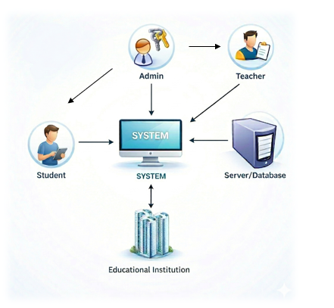
7-System architecture
Overview about Student Portal Architecture The system uses a centralized and modular architecture, where all academic functions are integrated into one platform. The central system connects and manages all operations efficiently.
Key Modules:
Student Management
Teacher Management
Attendance Management
Assignment & Materials
Performance Prediction (ML)
Communication System
Admin Control
Data & Security
All modules are interconnected, enabling smooth data flow, real-time updates, and effective communication.
Benefits: By using this system, we achieve Scalable, Reliable, and Secure academic management with intelligent insights.

Slide 11
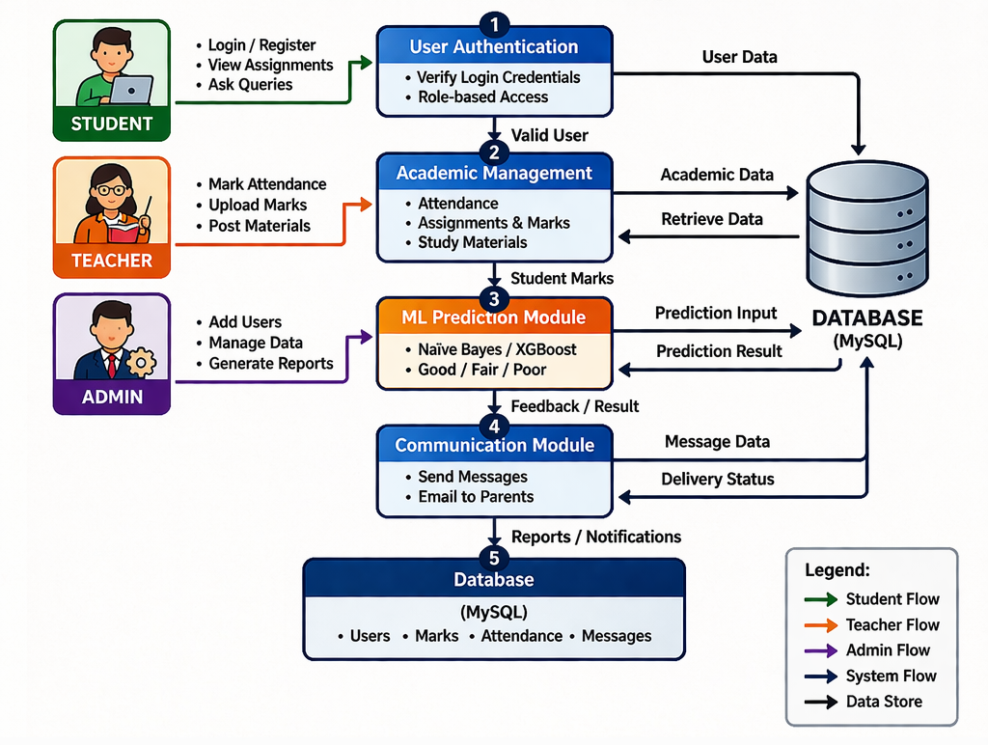
8-Data flow diagram of student portal
1. Authentication: Handles student, teacher, and admin login, registration, and validation.
The system consists of multiple modules that manage academic operations efficiently.
2. Student Management: Stores and manages student details in the Student DB.
3. Teacher Management: Manages teacher information and stores it in the Teacher DB.
4. Attendance Management: Handles student attendance records stored in the Attendance DB.
5. Assignment & Marks Management: Manages assignments, uploads, and marks stored in the Academic DB.
6. Performance Prediction (ML): Predicts student performance using Naïve Bayes and XG Boost, results stored in Prediction DB.
7. Communication Module: Handles messages and emails between students, teachers, and parents stored in Communication DB.
All modules are connected to a centralized database system for efficient data storage and retrieval.
8. Admin Control: Admin monitors and manages all academic data and user activities.

Slide 12
9-Uml diagrams
USE CASE DIAGRAMS
Use Case Diagram is a UML diagram used to show system functionality.
It represents actors (Student, Teacher, Admin) and their interactions.
Each actor performs actions called use cases login, upload marks, view data, etc.
It shows who can do what in the system.
Helps in understanding system features in a simple visual way.

Slide 13
10-Uml diagrams
CLASS DIAGRAM
A Class Diagram is a UML diagram used to show system structure.
It represents different classes Admin, Teacher, Student.
Each class has attributes data and methods functions.
It shows relationships between classes association, inheritance.
Helps to understand system design in a clear and organized way.

Slide 14
11-Uml diagrams
SEQUENCE DIAGRAM
A Sequence Diagram shows interaction between objects in a system.
It represents actions in a time-ordered sequence, showing how events occur step by step from start to end.
It illustrates step-by-step communication between different components of the system.
Objects interact by sending messages requests and responses to each other.
It also includes elements like actors, lifelines, and message flows to represent system behavior over time.
It helps to understand the flow of operations clearly and is useful for analyzing how the system works in real-time scenarios.

Slide 15
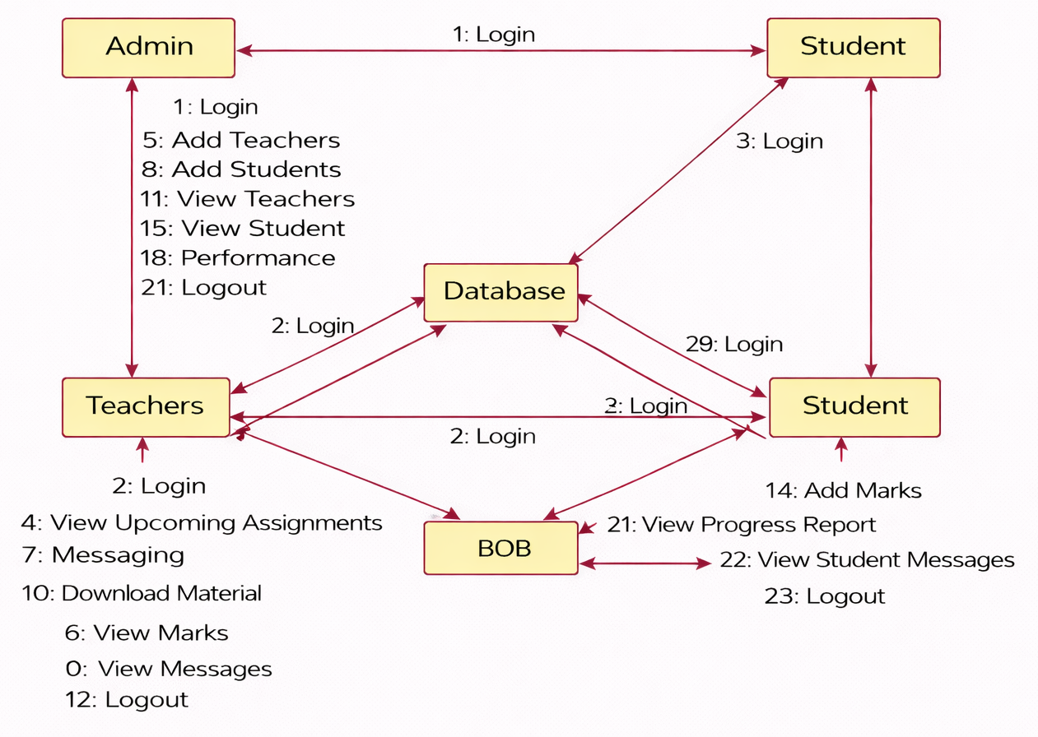
12-Uml diagrams
COLLABORATIVE DIAGRAM
A Collaboration Diagram shows how objects interact with each other in a system.
It focuses on the relationships between objects (Admin, Teacher, Student, Database).
Objects communicate by sending messages with sequence numbers.
It shows who interacts with whom in the system.
Helps to understand the overall communication structure clearly.
Useful for visualizing object connections and message flow.

Slide 16
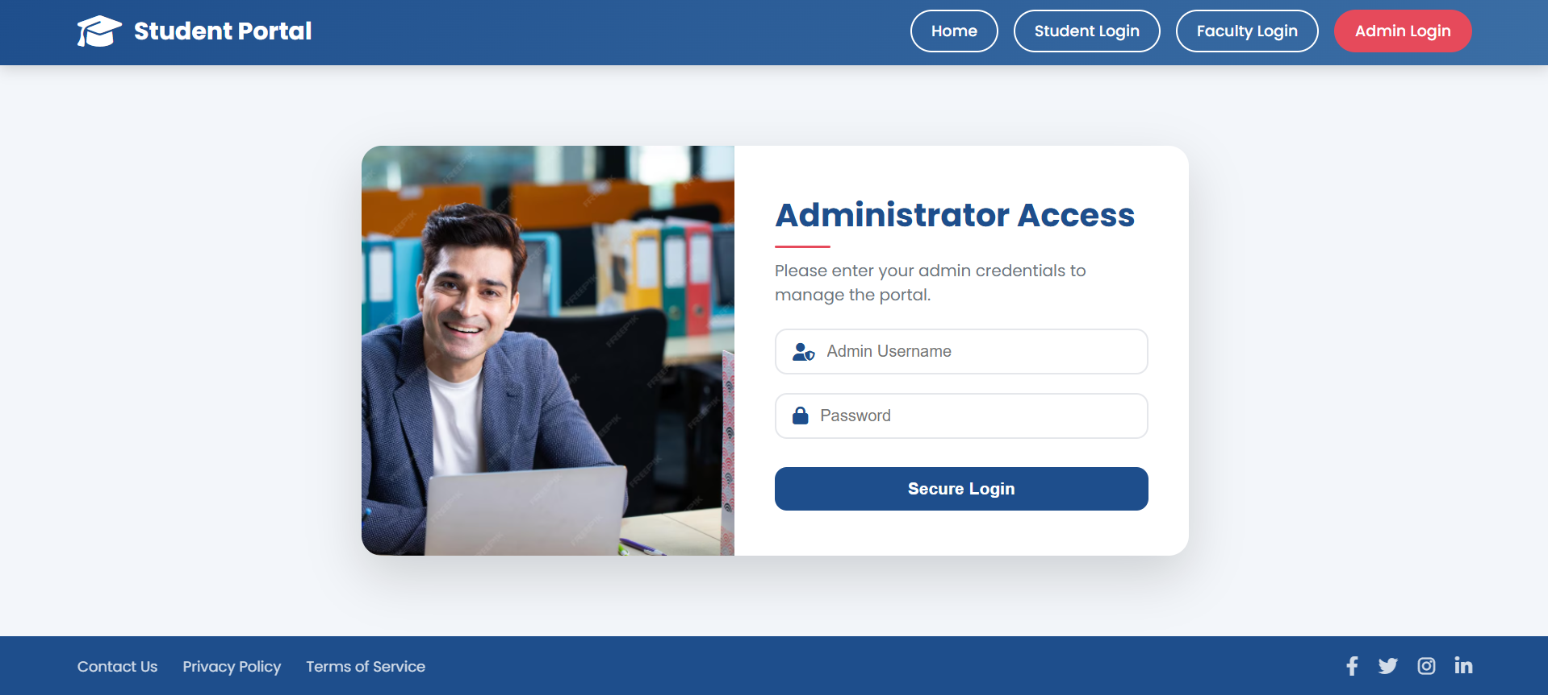
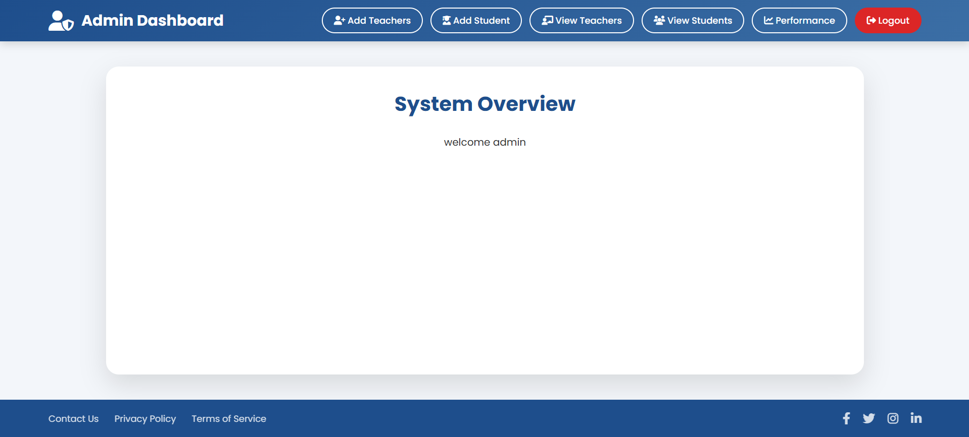
13-project modules - Admin Module
Login process:
The user (Admin/Teacher/Student) logs into the Student Portal through a secure login page by entering a valid username and password. The system verifies the credentials, and upon successful authentication, the user is redirected to their respective dashboard.
After login:
Admin: The Admin can manage teachers and students, view records, and monitor overall performance.
Teacher: The Teacher can mark attendance, create assignments, upload materials, add marks, and communicate with students.
Student: The Student can view assignments, download study materials, check marks, view messages, and track performance.
Logout: The user can securely log out from the system after completing tasks.

Slide 17
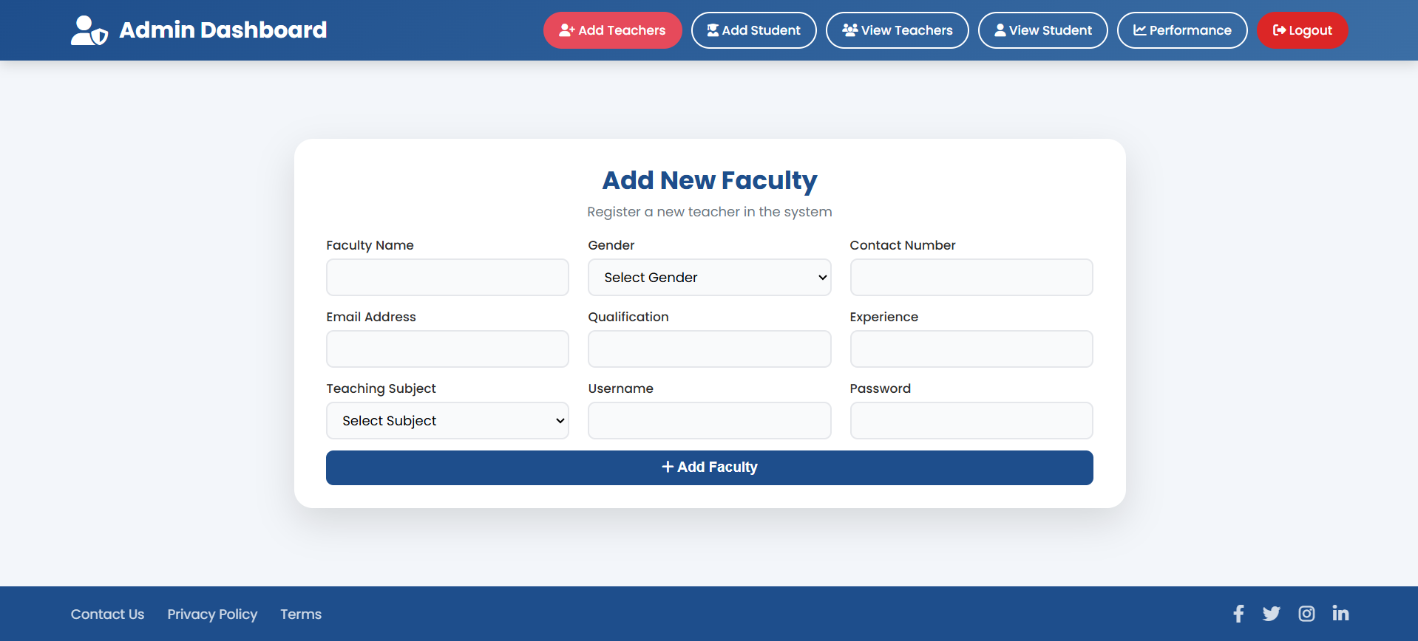
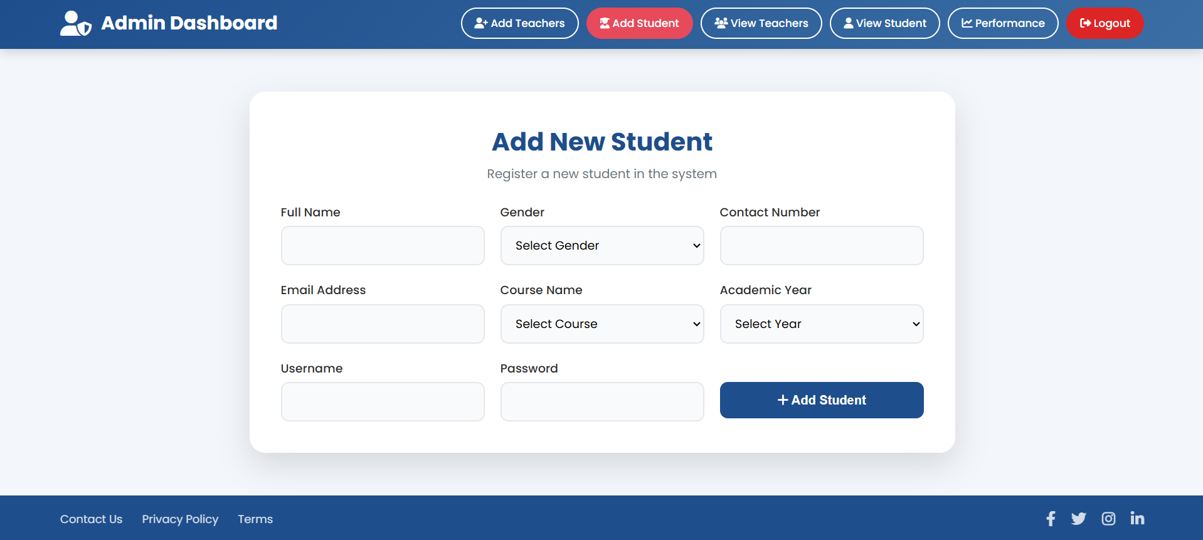
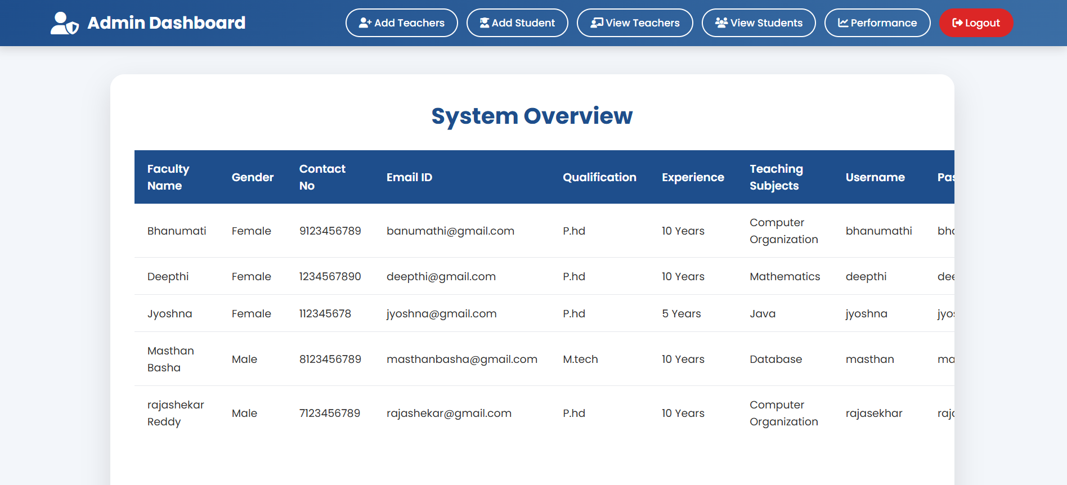
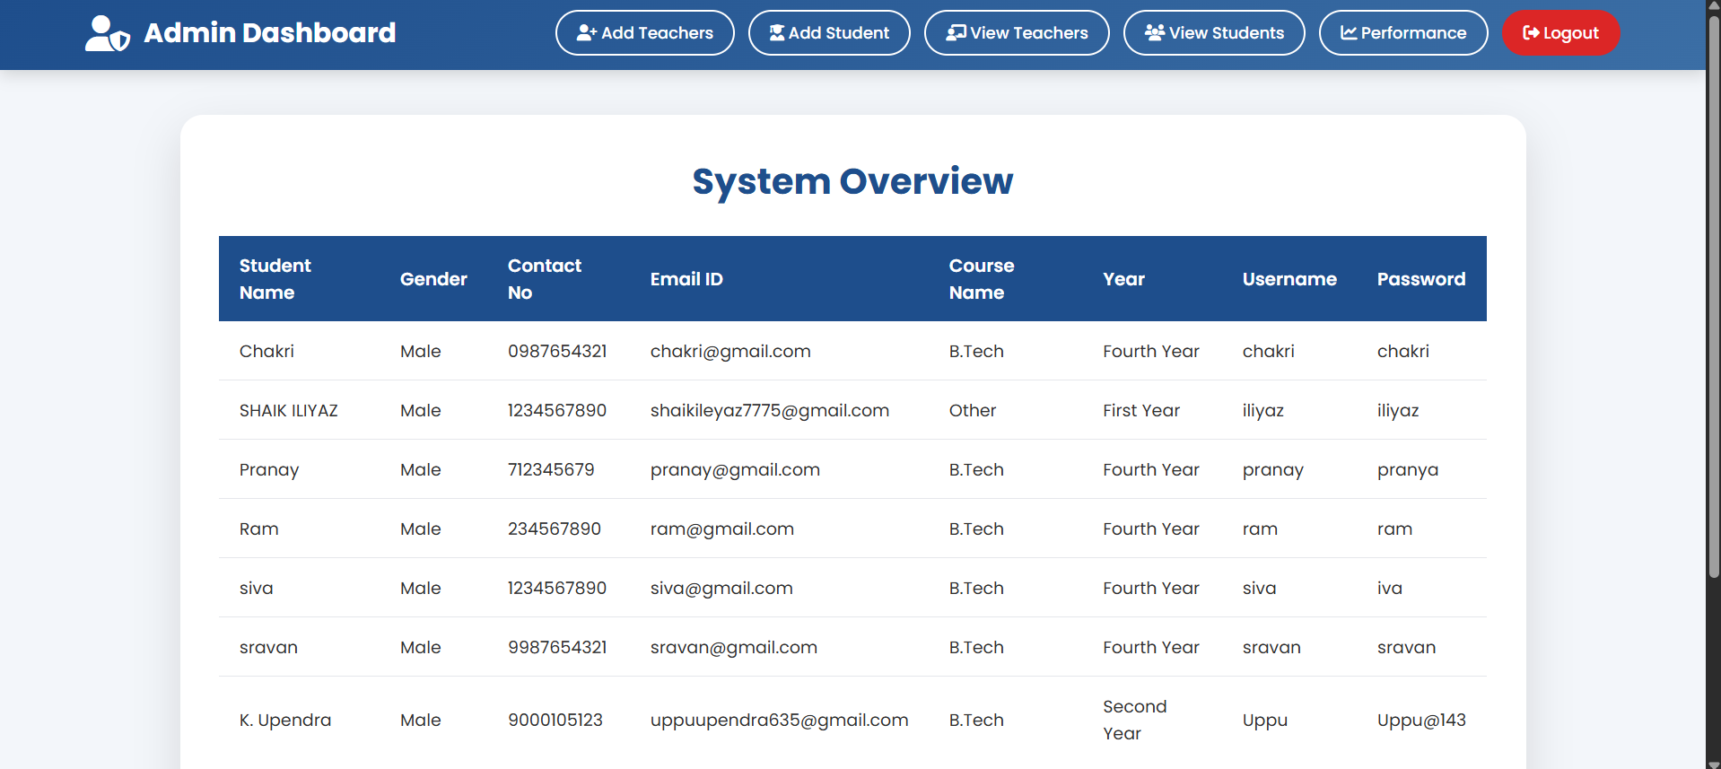
14-project modules - Student Module
Add Teachers: Admin can add new teachers to the system.
Add Students: Admin can register new students.
View Teachers: Admin can view the list of all teachers.
View Students: Admin can view the list of all students.

Slide 18
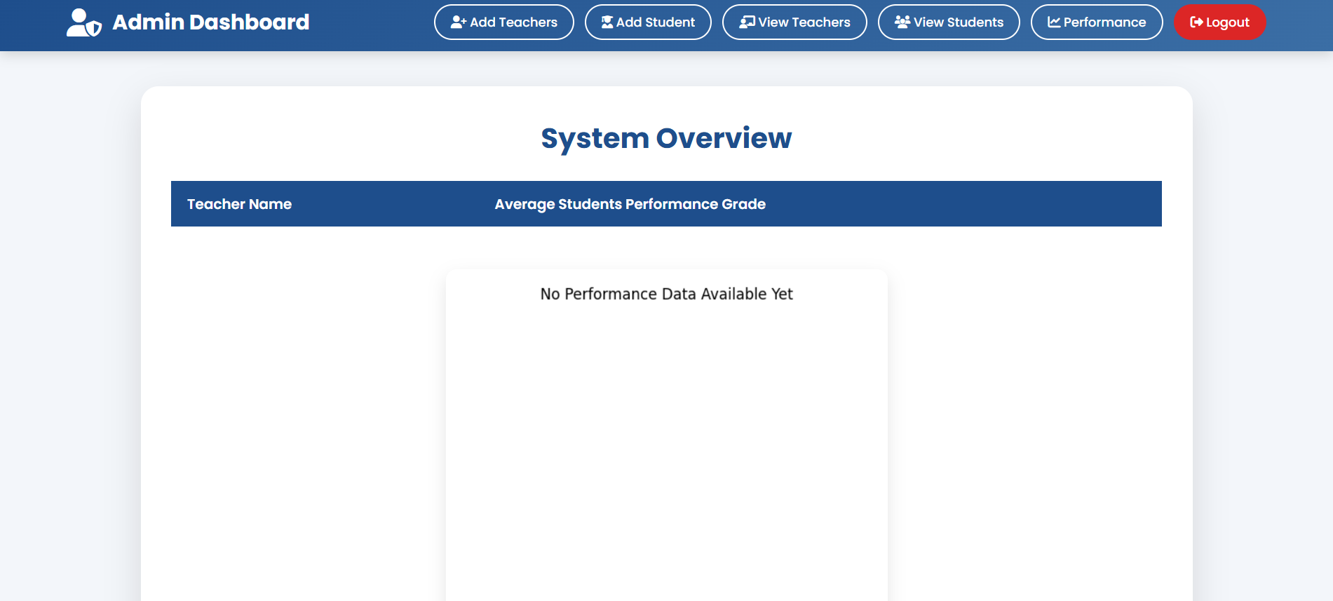
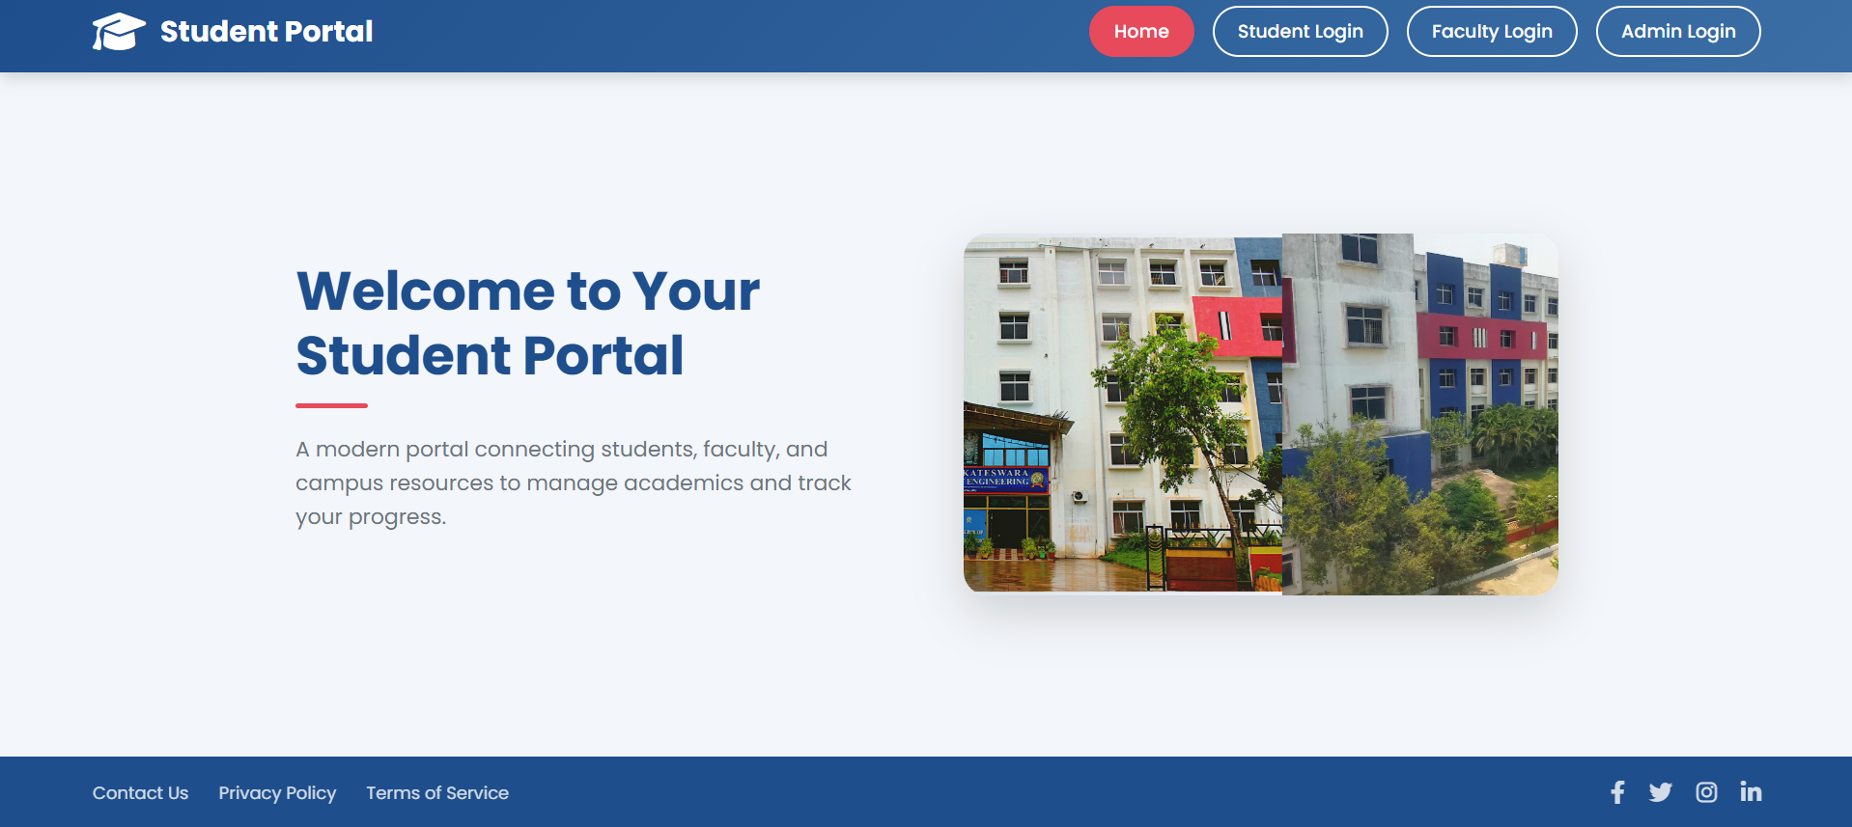
15-project modules - Student Module
Performance: Admin can monitor average student performance based on teachers.
Logout: Admin can securely log out from the system. Redirect: To Faculty Dashboard after logout

Slide 19
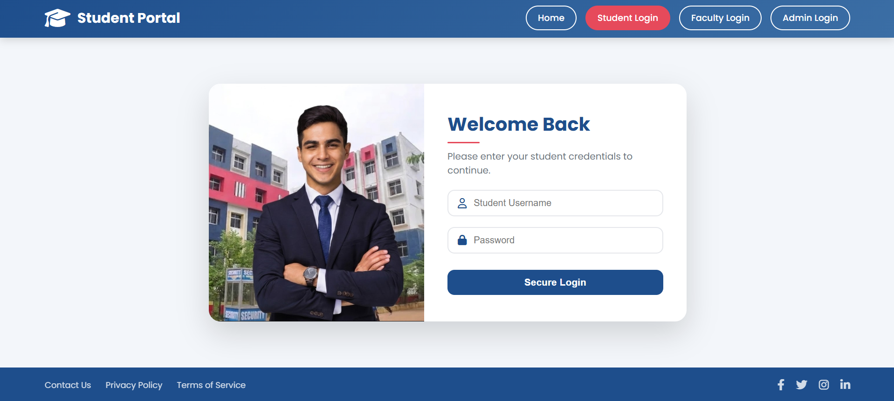
16-project modules - Student Module
Login process:
Students log in to the system by entering their valid username and password on the login page. The system verifies the credentials, and upon successful authentication, the student is redirected to the student dashboard.
After login:
View Profile: Students can view and update their personal details and academic information.
View Assignments: Students can check upcoming assignments given by teachers.
Download Materials: Students can download study materials uploaded by teachers.
View Marks: Students can view their subject-wise marks and performance.
Messaging: Students can send and receive messages from teachers.
Logout: Students can securely log out from the system after completing tasks.

Slide 20
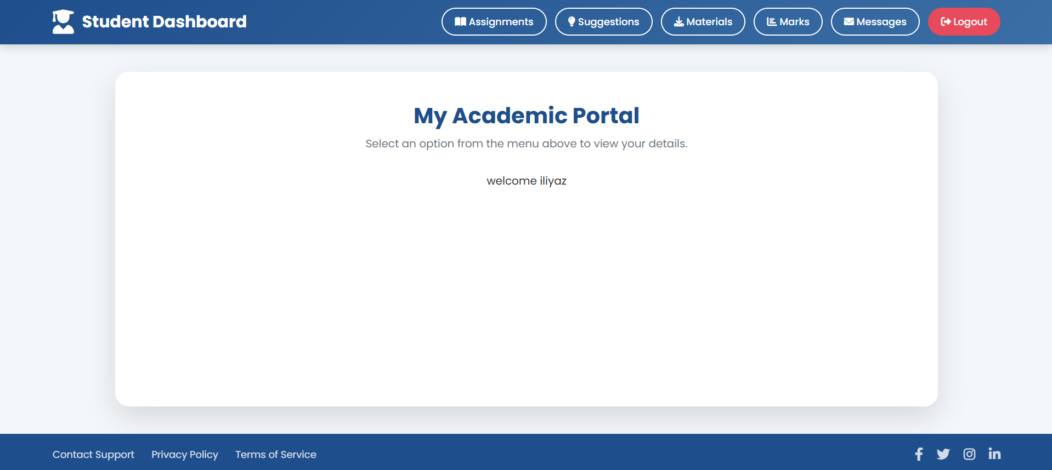
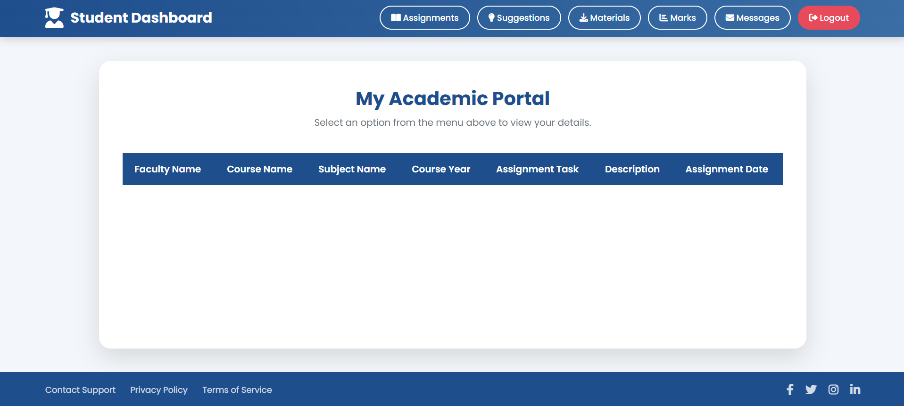

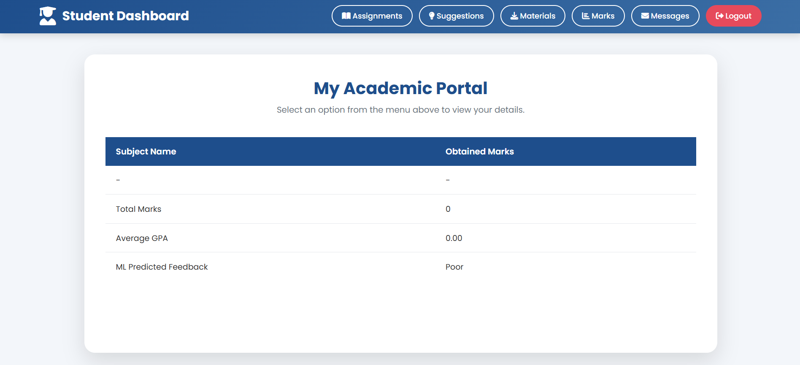
17-project modules - Student Module
View Profile: Students can view and update their personal details and academic information.
View Assignments: Students can check upcoming assignments given by teachers.
Download Materials: Students can download study materials uploaded by teachers.
View Marks: Students can view their subject wise marks and performance.

Slide 21
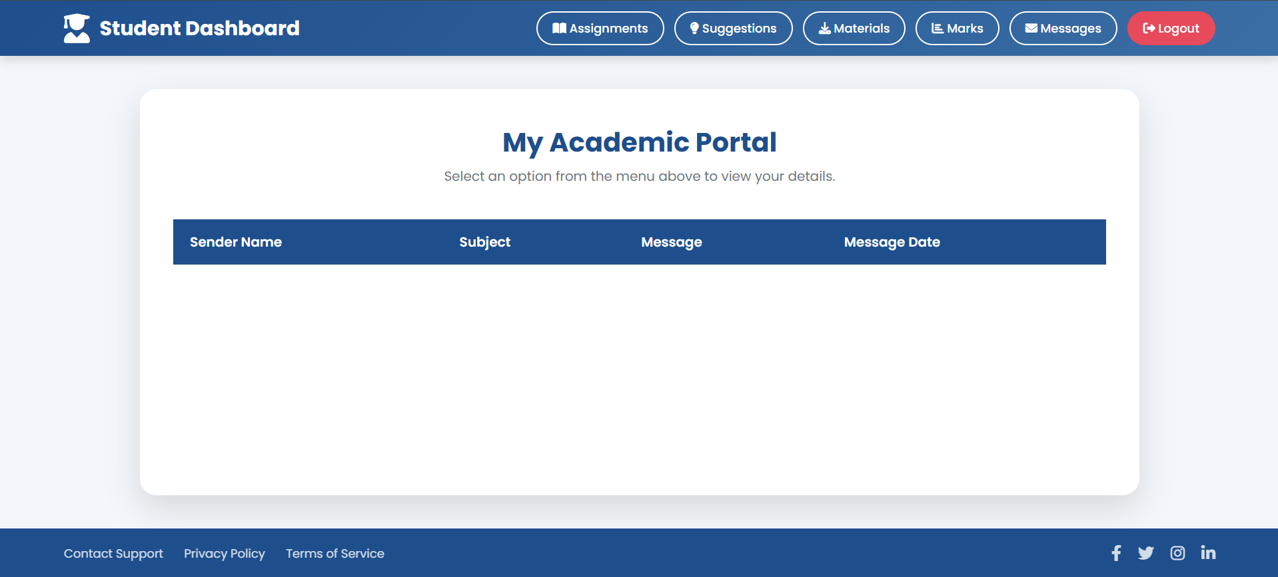
18-project modules - Student Module
Messaging: Students can send and receive messages from teachers.
Logout: Students can securely log out from the system after completing tasks. Redirect: To Faculty Dashboard after logout

Slide 22
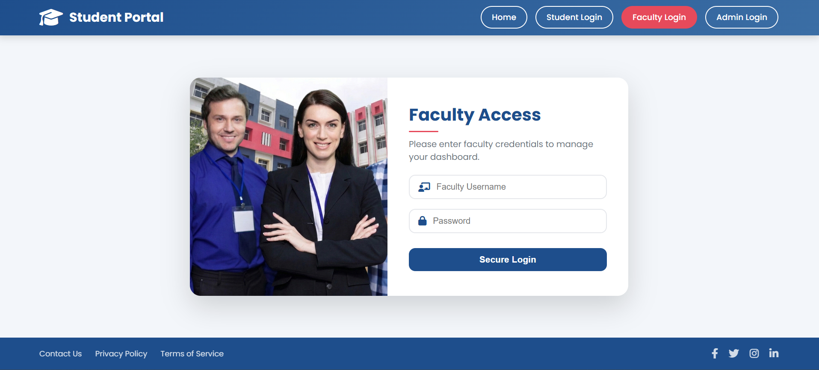
19-project modules - Faculty Module
Login process:
Faculty log in to the system by entering their valid username and password on the login page. The system verifies the credentials, and upon successful authentication, the Faculty is redirected to the Faculty dashboard.
After login:
Attendance: Faculty can mark and manage student attendance.
Assignments: Faculty can create and manage assignments.
Material: Faculty can upload and share study materials.
Marks: Faculty can add and update student marks.
Messaging: Faculty can communicate with students and parents.
Reports: Faculty can view student performance reports.
Inbox: Faculty can check messages received from students.
Logout: Faculty can securely log out from the system.

Slide 23
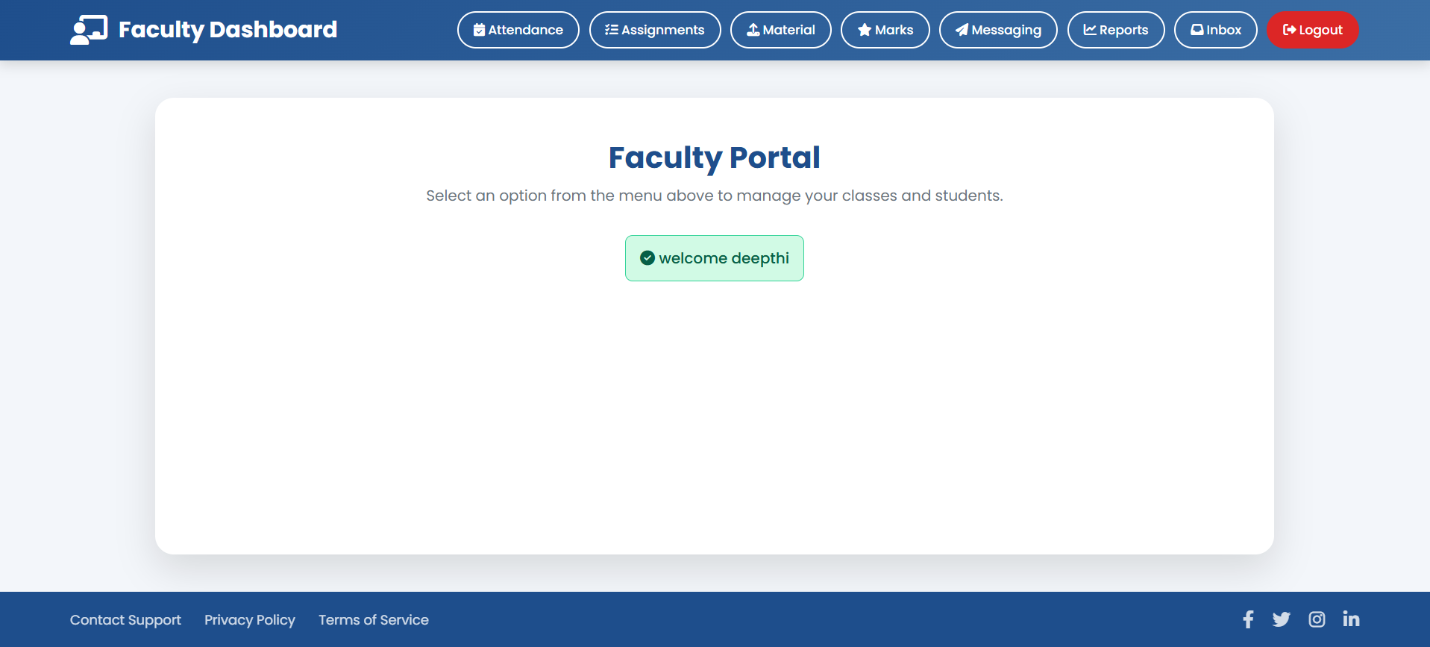
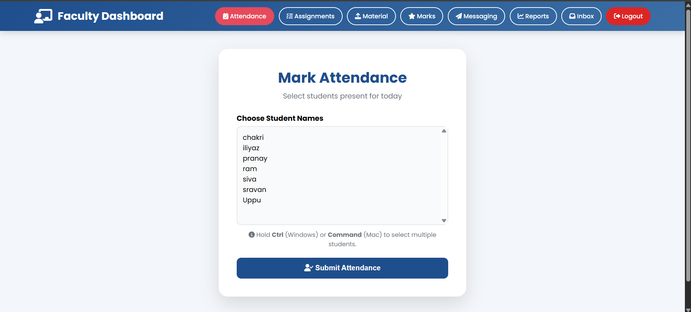
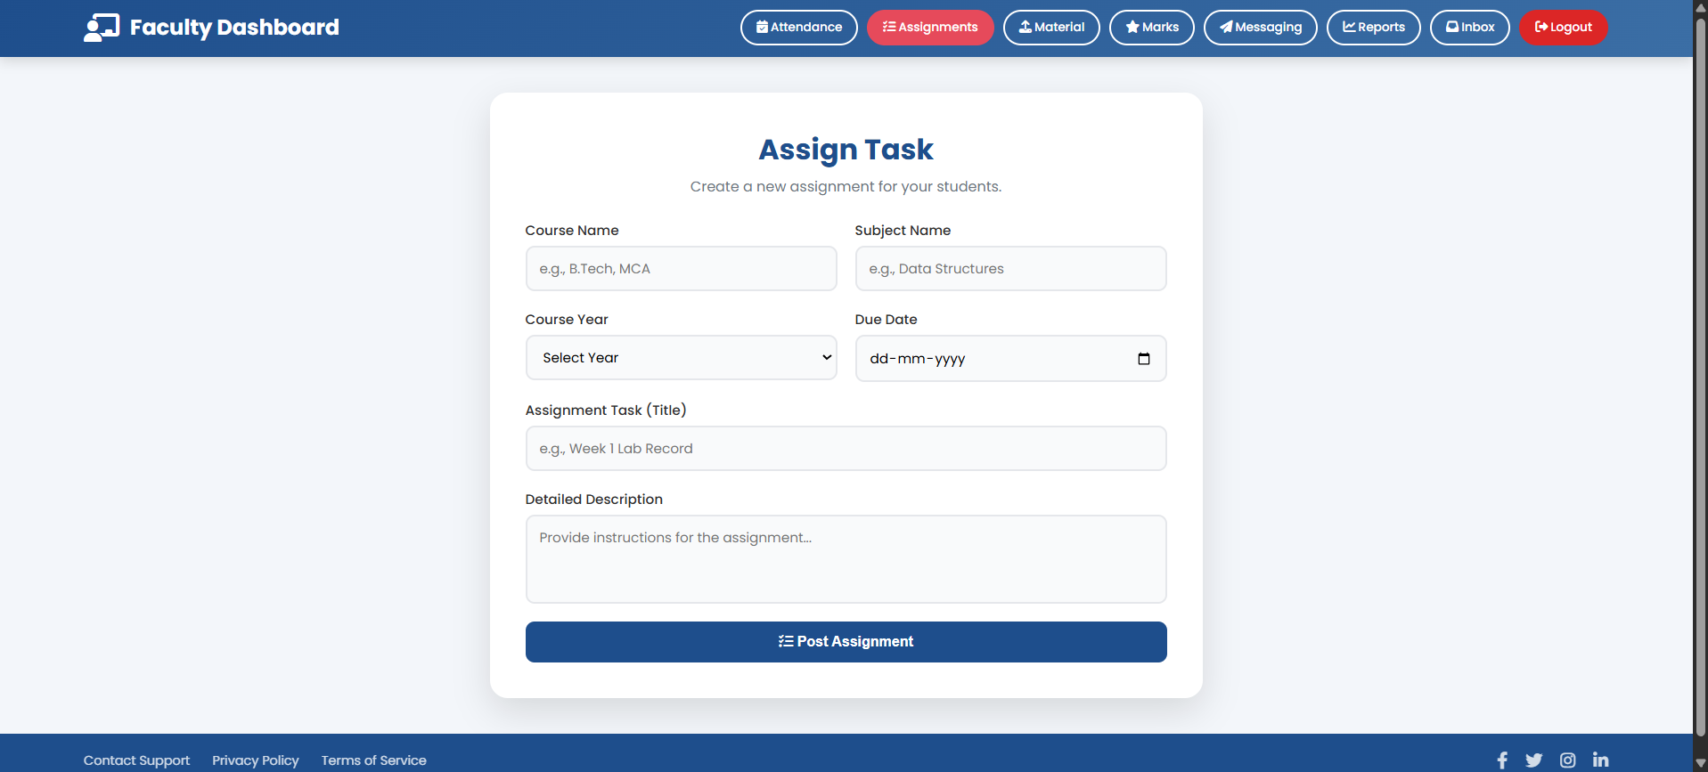
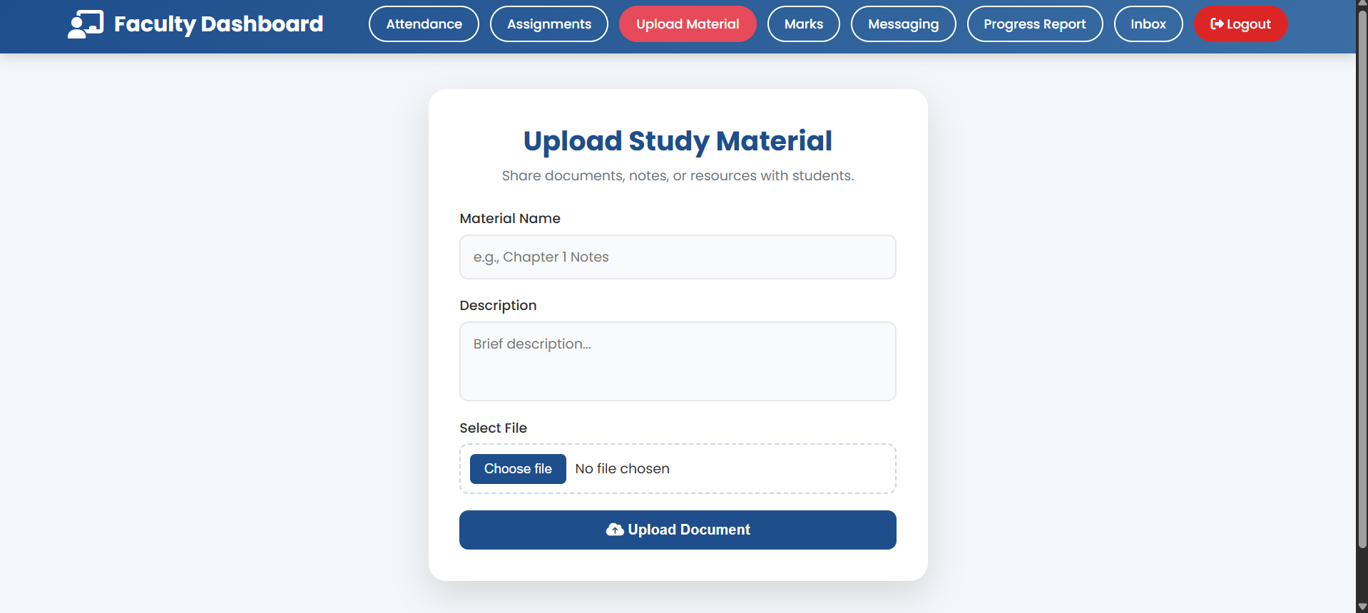
20-project modules - Student Module
View Profile: Faculty can view and update their details and academic information.
Attendance: Faculty can mark and manage student attendance.
Assignments: Faculty can create and manage assignments.
Material: Faculty can upload and share study materials.

Slide 24
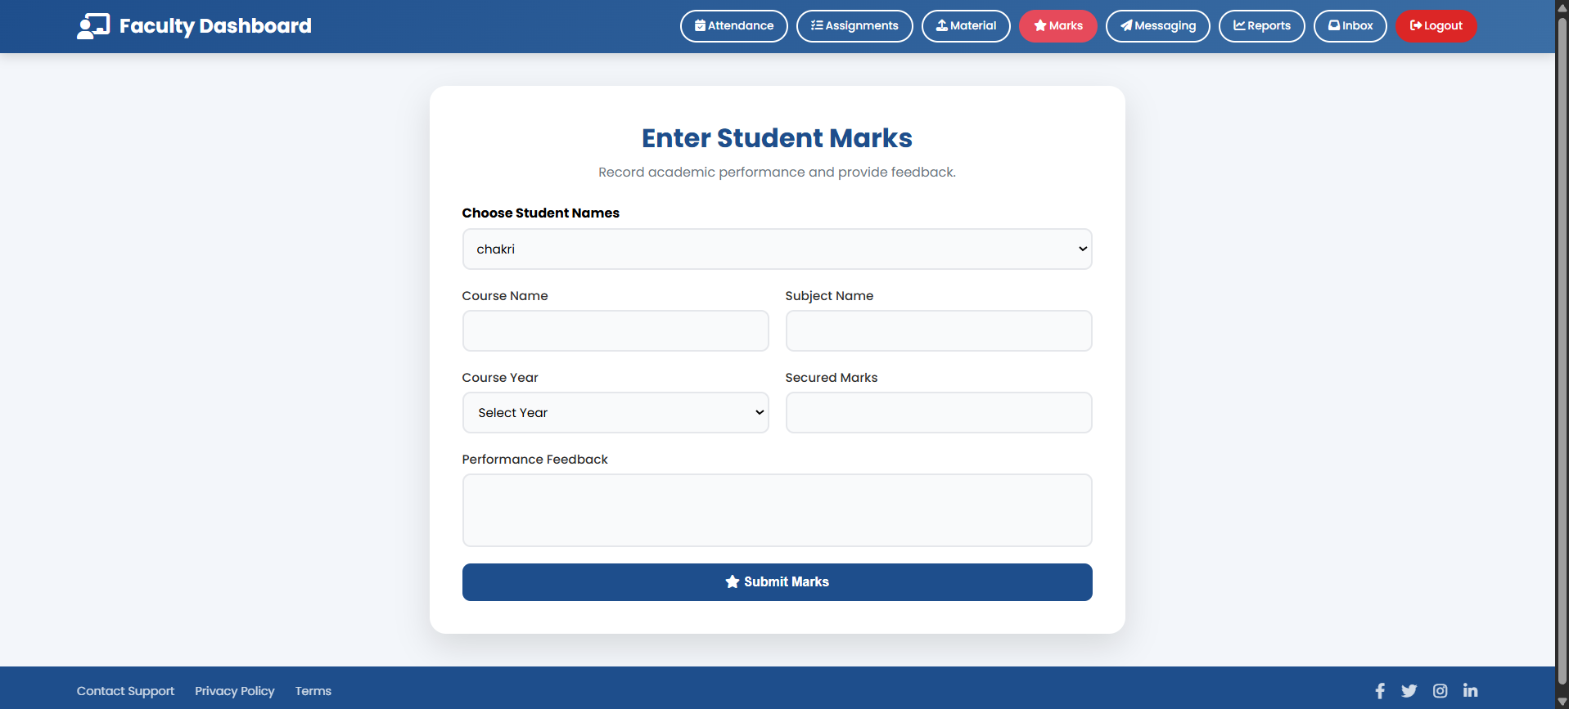
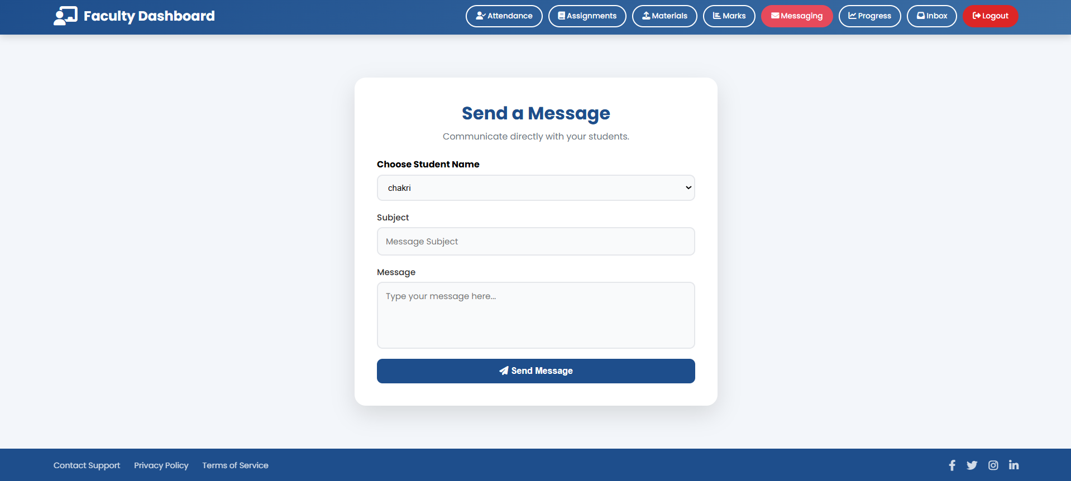
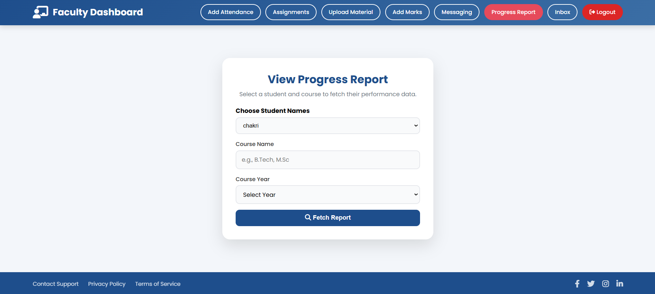
21-project modules - Student Module
Marks: Faculty can add and update student marks.
Messaging: Faculty can communicate with students and parents.
Reports: Faculty can view student performance reports.
Inbox: Faculty can check messages received from students.

Slide 25
22-project modules - Student Module
Logout: Faculty can securely log out from the system.
Redirect: To Faculty Dashboard after logout

Slide 26

23-Methodology
Machine Learning Performance Prediction Machine Learning (Native Bayes and XG Boost) is used to predict student performance based on academic data.
Prediction Output Processing The system processes prediction results and displays insights to users.
Steps:-
Input new student data into trained model.
Generate prediction result (Good / Fair / Poor).
Compare with previous performance (optional).
Display results on dashboard (Student/Teacher/Admin).
Store prediction results in database.
Use results for reports and decision-making.
Steps:-
Student academic data (marks, attendance) is collected.
Data is preprocessed (cleaning, normalization).
Features are selected (subjects, attendance, scores).
ML models (Naïve Bayes, XG Boost) are trained on historical data.
The trained model analyzes new student data.
Predicts performance as Good / Fair / Poor.

Slide 27

24-system testing
TESTING
TEST CASES
Actually, we performed test cases on different modules.
The testing strategy uses manual testing verify the inputs, links, and pages, validate data formats, prevent duplicates, and ensure accurate and efficient system performance.
TESTING METHODS
These are some important testing used in the project:
Unit Testing
Integration Testing
Functional Testing
System Testing
White Box Testing
Black Box Testing
Acceptance Testing
Example: Testing Login Module
Test Case ID: TC_001
Test Case Description: Verify login functionality with valid credentials
Precondition: User must be registered and database connected
Steps:
Open login page
Enter valid username & password
Click login
Expected Result: System should validate user and allow access
Actual Result: System validates user and checks in database successfully
Status: Pass

Slide 28
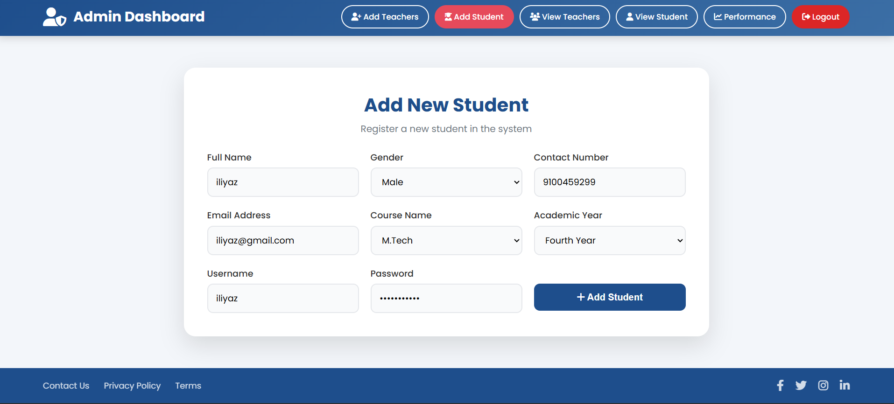

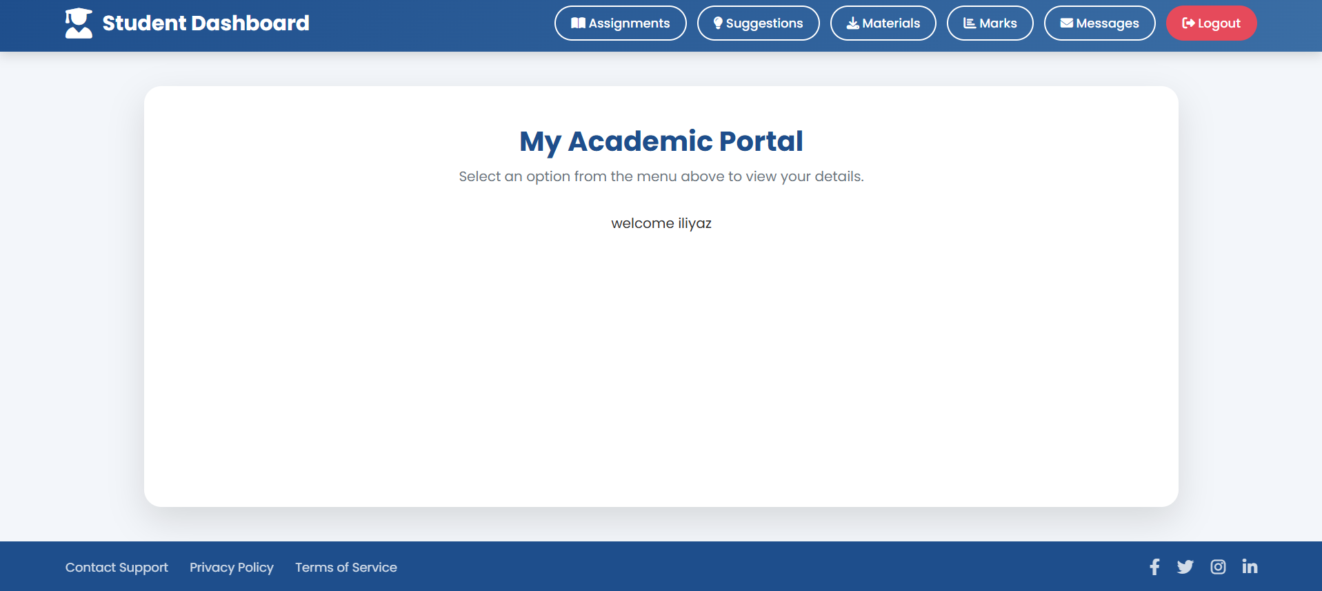
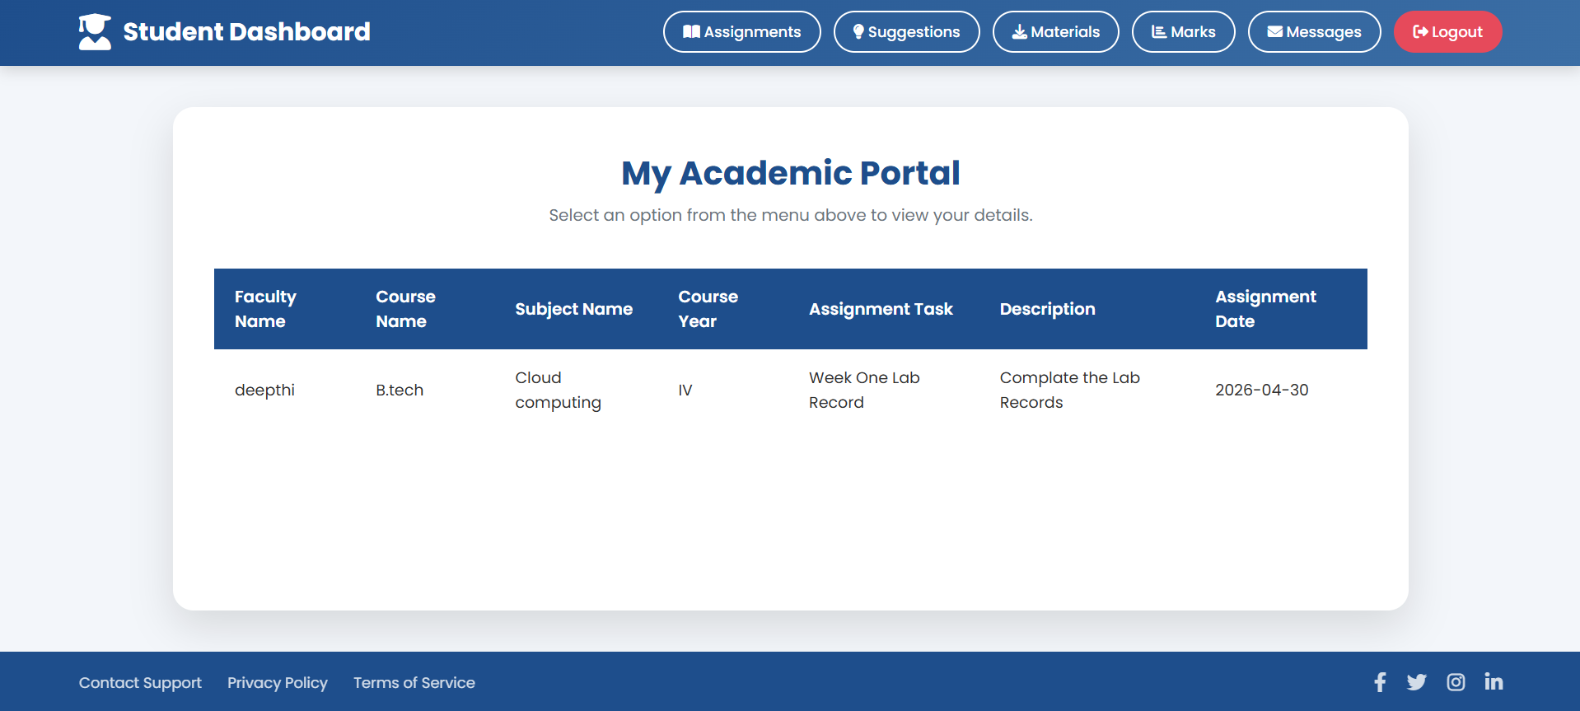
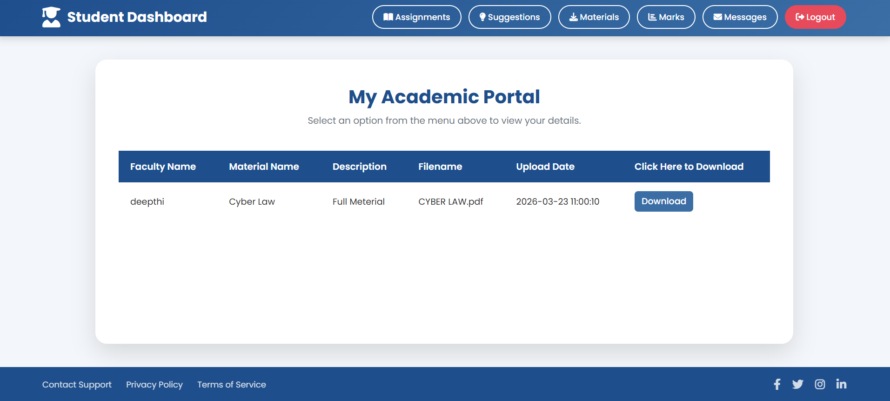
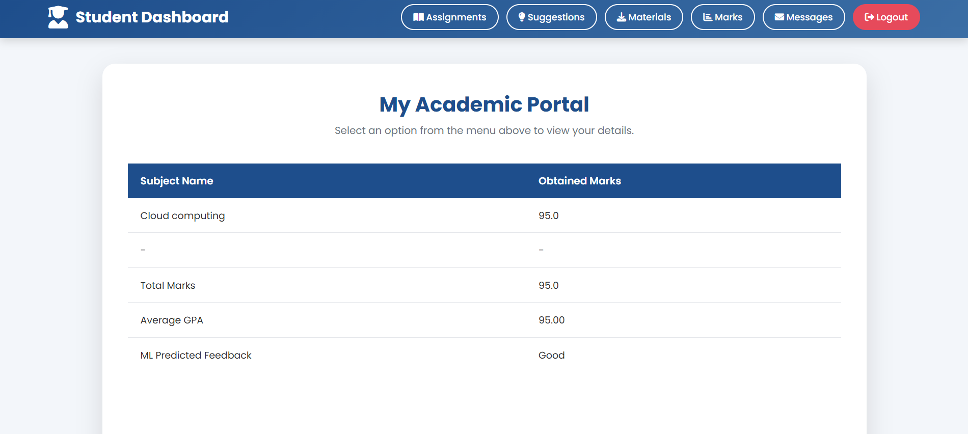
25-results

Slide 29

27-FUTURE SCOPE
The Student Portal can be enhanced by integrating advanced AI/ML models for more accurate student performance prediction and personalized learning recommendations.
Future improvements may include real-time analytics dashboards, mobile application support, and multilingual interfaces for better accessibility.
The system can also incorporate behavioral analysis, attendance patterns, and smart alerts to identify at-risk students early. Integration with cloud systems, third-party learning platforms, and automated report generation will further improve efficiency.
Continuous enhancements in security, scalability, and user experience will make the platform more robust and widely adaptable.

Slide 30

28-conclusion
The Student Portal is a centralized and intelligent academic management system that integrates machine learning with education to improve student performance monitoring and decision-making.
It provides a unified platform for Admin, Teacher, and Student interactions, ensuring smooth communication and efficient data management.
By using algorithms like Naïve Bayes and XG Boost, the system predicts student performance with high accuracy (over 93%), enabling early intervention and better academic planning.
The portal simplifies tasks such as assignment management, attendance tracking, material sharing, and messaging.
Overall, the system enhances transparency, efficiency, and data-driven insights, making it a valuable solution for modern educational institutions and future-ready learning environments.

Slide 31

29-bibliography
Romero & Ventura (2010): Educational Data Mining overview for analysing student data.
Baker & Inventado (2014): Learning Analytics to improve learning outcomes.
Kotsiantis et al. (2004): Student performance prediction using Machine Learning.
Chen & Guestrin (2016): XGBoost algorithm for high accuracy prediction.
Django Software Foundation (2024): Django framework documentation for web development.

Slide 32


